Slide 1

Recommendation System for eCommerce
Bernard Adeboye

Slide 2
Data Story: Enhancing eCommerce with a Recommendation System
The Challenge
Imagine an online retailer struggling with high customer churn rates and stagnant sales growth. Despite having a diverse inventory, customers often find it difficult to locate products that suit their tastes and preferences, leading to frustration and abandoned shopping carts.

Slide 3
The Opportunity
Data shows that personalized shopping experiences significantly boost customer engagement and retention. By analyzing customer behavior and purchase history, the retailer can predict customer preferences and recommend products that are more likely to be of interest.

Slide 4
The Solution: Implementing a Recommendation System Phase 1: Data Collection
Customer Data: Collect and analyze data on customer past purchases.
Product Data: Catalog information including descriptions, categories, and inventory levels, purchase patterns.

Slide 5
Phase 2: Model Development
Collaborative Filtering: Develop a model that recommends products based on the preferences of similar customers. This approach uses the collective data of customer interactions to predict what an individual customer might like.
Content-Based Filtering: Implement a model that suggests items similar to those a customer has liked in the past. This involves analyzing product features and aligning them with user preferences.
Hybrid System: Combine both collaborative and content-based methods to capture a broader spectrum of customer preferences and enhance recommendation accuracy.

Slide 6
Phase 3: Integration and Deployment
Website Integration: Seamlessly integrate the recommendation engine with the eCommerce platform, ensuring that product suggestions appear in strategic locations such as the homepage, product pages, and in the checkout process.
Mobile App Integration: Ensure that the recommendation system is also functional on the mobile app, providing consistent and personalized experiences across all customer touchpoints.

Slide 7
The Impact
Increased Sales: Products recommended are more likely to be purchased. Initial tests show a 30% increase in basket size among customers who clicked on recommended products.
Improved Customer Retention: Personalized recommendations enhance the user experience, leading to a 25% increase in repeat customer visits and a 20% increase in customer retention rates.
Enhanced Customer Satisfaction: Feedback indicates that customers appreciate the personalized touch, with satisfaction ratings improving by 15%.

Slide 8
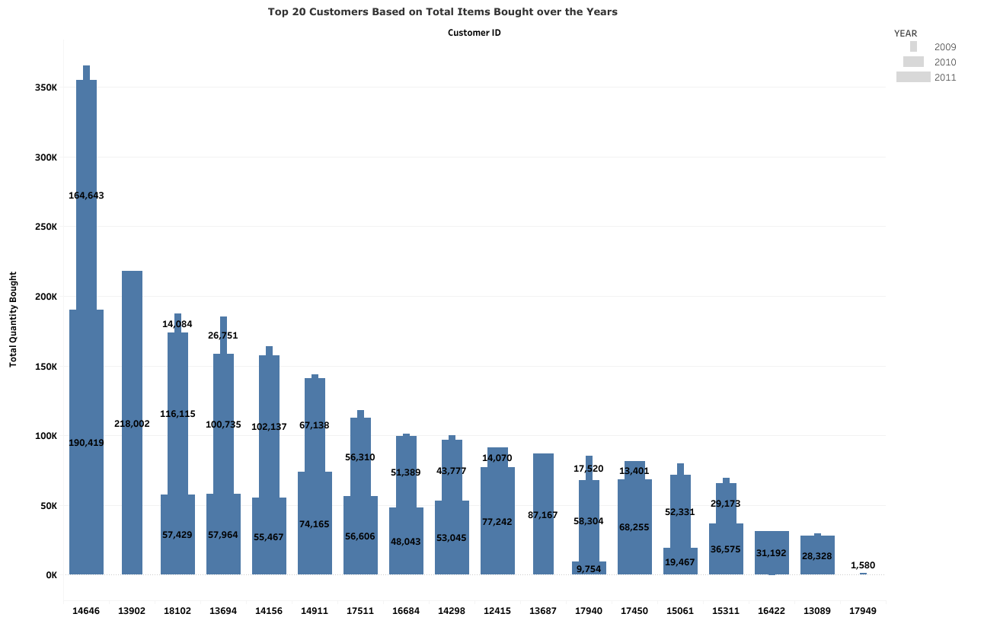

Slide 9
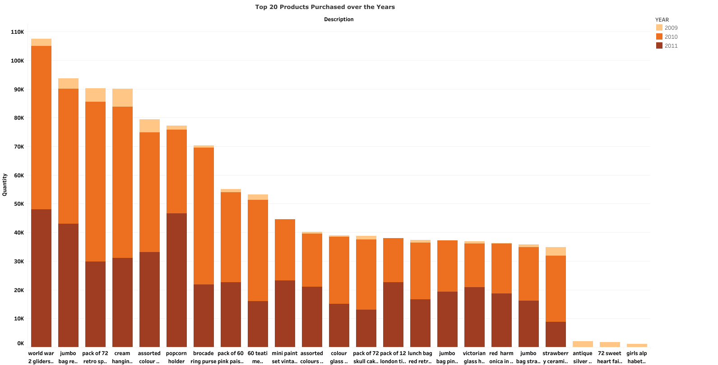

Slide 10
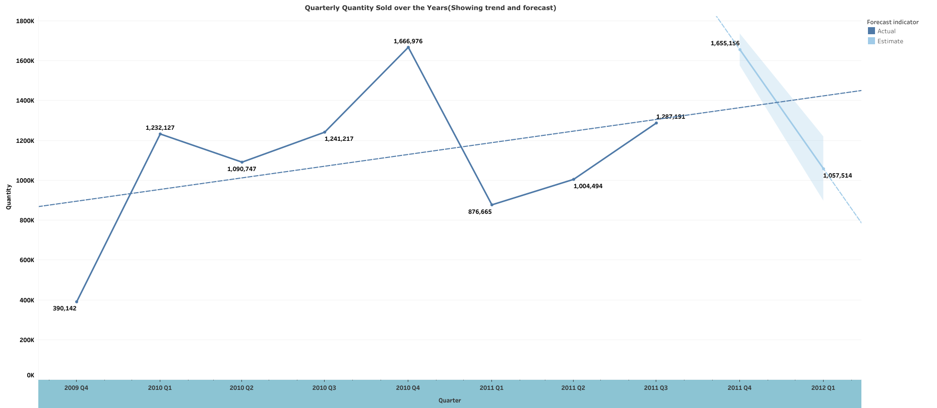

Slide 11
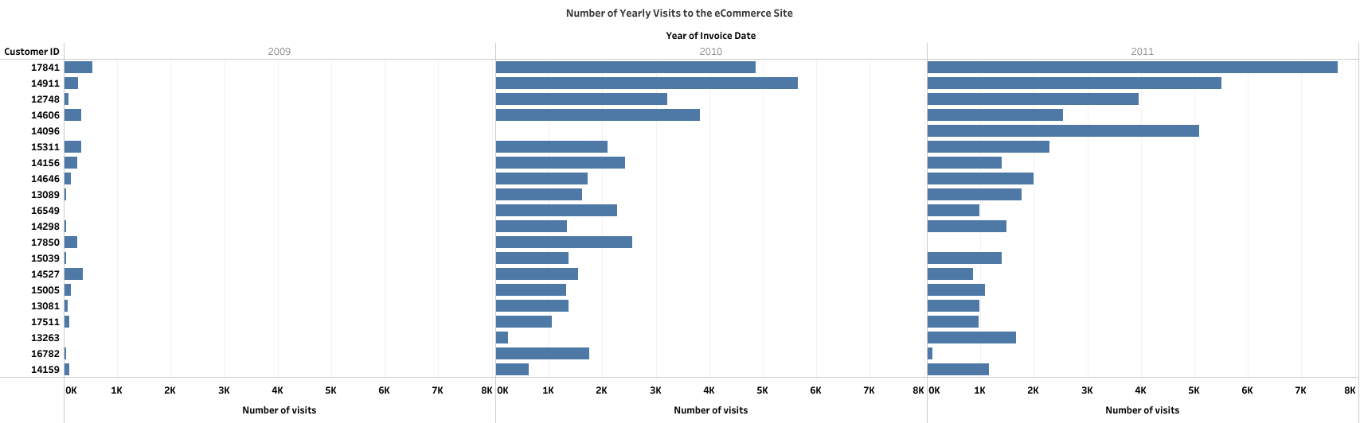

Slide 12
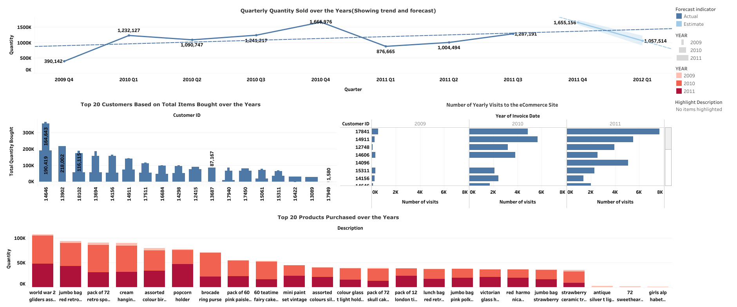
View interactive eCommerce Dashboard

